Slide 1

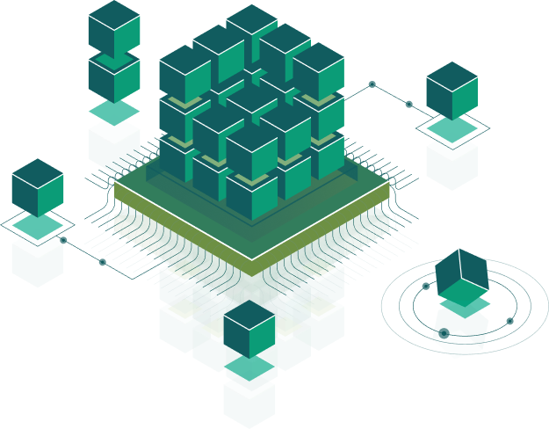
Architectural patterns: MVVM, MVC (Frontend)
Speaker:
Taras Aftanashchuk
Notes:
Introduce course and speacers

Slide 2
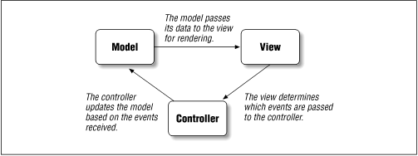
MVC Angular architecture
Services
Html
Css
Component
Notes:
micrisoft team work

Slide 3
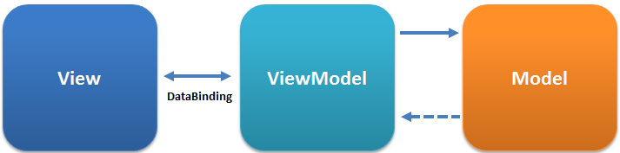
Component
MVVM Angular architecture
Html
Css
Component
Services
Notes:
micrisoft team work

Slide 4
Recommendation
Use patterns
Don't blend UI and logic(show notification in logic service ….)
KISS, DRY, SOLID
Notes:
micrisoft team work

Slide 5

Thank you!

